Slide 1
High-throughput experiments elucidate the impact of multicomponent interactions on solute transport in complex feed streams
Laurianne Estrada, Jonathan A. Ouimet, William Phillip

Slide 2
Single Salt Experiments

Slide 3
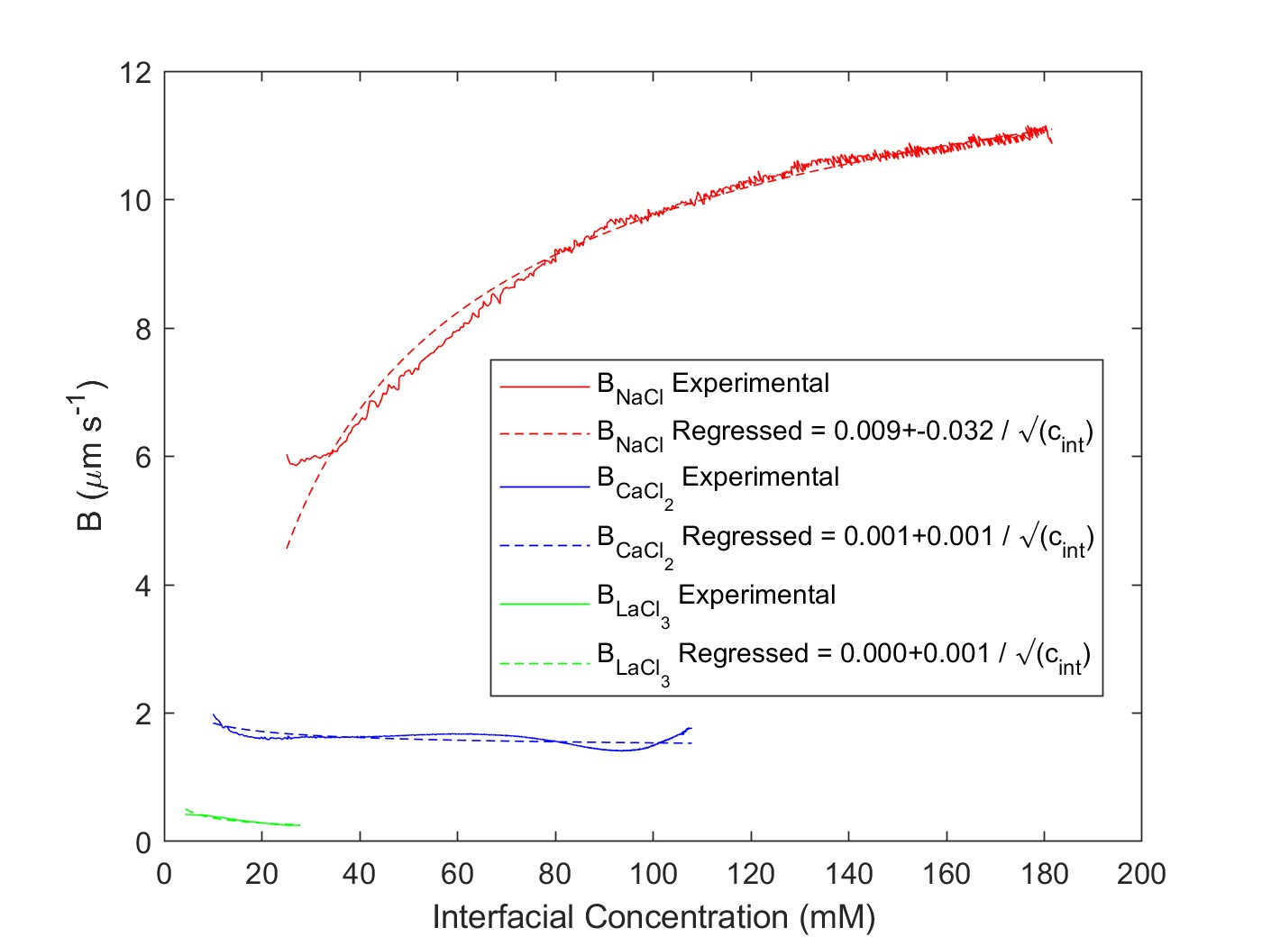


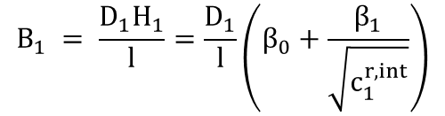
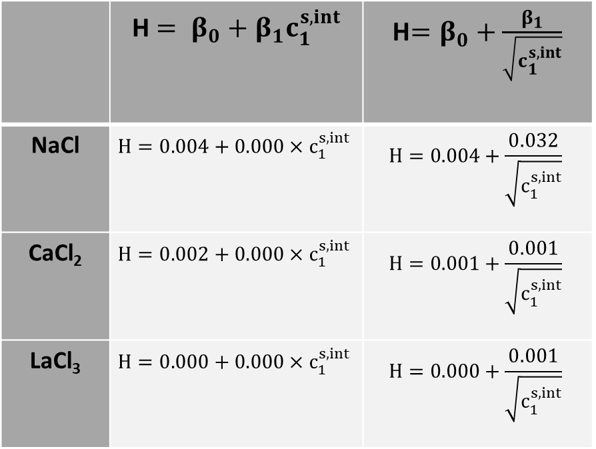
Feed: 1 mM NaCl
Diafiltrate: 150 mM NaCl
$$B_{1} = \frac{D_{1}H_{1}}{l}=\frac{D_{1}}{l}\left(β_{0}+\frac{β_{1}}{\sqrt{c_{1}^{r,int}}}\right)$$
Feed: 1 mM CaCl2
Diafiltrate: 75 mM CaCl2
$$J_{s,i exp}=J_{w}c_{i}^{p}$$
Feed: 1 mM LaCl3
Diafiltrate: 20 mM LaCl3
$$J_{s,i theo}=B_{1}∆c_{i}$$
 | H$= β_{0}+β_{1}c_{1}^{s,int}$ | H$=β_{0}+\frac{β_{1}}{\sqrt{c_{1}^{s,int}}}$
NaCl | $$H=0.004+0.000{×c}_{1}^{s,int}$$ | $$H=0.004+\frac{0.032}{\sqrt{c_{1}^{s,int}}}$$
CaCl₂ | $$H=0.002+0.000{×c}_{1}^{s,int}$$ | $$H=0.001+\frac{0.001}{\sqrt{c_{1}^{s,int}}}$$
LaCl₃ | $$H=0.000+0.000{×c}_{1}^{s,int}$$ | $$H=0.000+\frac{0.001}{\sqrt{c_{1}^{s,int}}}$$

Slide 4
Multicomponent Experiments

Slide 5
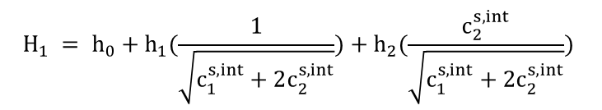
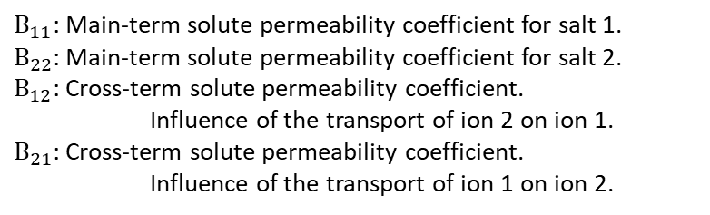
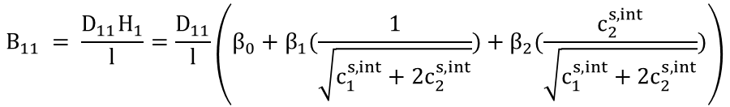


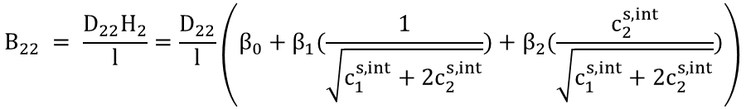
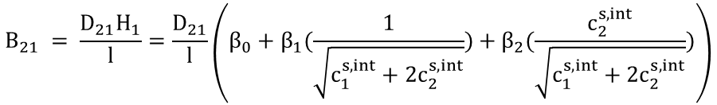
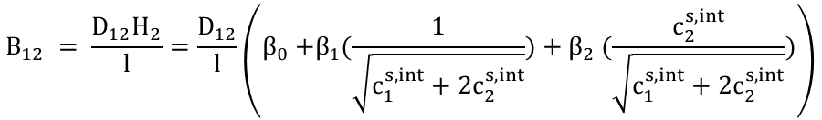
Nomenclature and Multi Salt Equations
$B_{11}$: Main-term solute permeability coefficient for salt 1.
$B_{22}$: Main-term solute permeability coefficient for salt 2.
$B_{12}$: Cross-term solute permeability coefficient.
Influence of the transport of ion 2 on ion 1.
$B_{21}$: Cross-term solute permeability coefficient.
Influence of the transport of ion 1 on ion 2.
$$B_{11} = \frac{D_{11}H_{1}}{l}=\frac{D_{11}}{l}\left(β_{0}+β_{1}(\frac{1}{\sqrt{c_{1}^{s,int}+2c_{2}^{s,int}}})+β_{2}(\frac{c_{2}^{s,int}}{\sqrt{c_{1}^{s,int}+2c_{2}^{s,int}}})\right)$$
$$B_{12} = \frac{D_{12}H_{2}}{l}=\frac{D_{12}}{l}\left(β_{0}{+β_{1}(\frac{1}{\sqrt{c_{1}^{s,int}+2c_{2}^{s,int}}})+β}_{2}(\frac{c_{2}^{s,int}}{\sqrt{c_{1}^{s,int}+2c_{2}^{s,int}}})\right)$$
$$J_{s,i exp}=J_{w}c_{i}^{p}$$
$$H_{1} = h_{0}+h_{1}(\frac{1}{\sqrt{c_{1}^{s,int}+2c_{2}^{s,int}}})+h_{2}(\frac{c_{2}^{s,int}}{\sqrt{c_{1}^{s,int}+2c_{2}^{s,int}}})$$
$$B_{21} = \frac{D_{21}H_{1}}{l}=\frac{D_{21}}{l}\left(β_{0}+β_{1}(\frac{1}{\sqrt{c_{1}^{s,int}+2c_{2}^{s,int}}})+β_{2}(\frac{c_{2}^{s,int}}{\sqrt{c_{1}^{s,int}+2c_{2}^{s,int}}})\right)$$
$J_{s,Na theo}=$ $B_{11}\left(c_{Na}^{r,int}−c_{Na}^{p}\right)+B_{12}\left(c_{Ca}^{r,int}−c_{Ca}^{p}\right)$
$$J_{s,Ca theo}=B_{21}\left(c_{Na}^{r,int}−c_{Na}^{p}\right)+B_{22}\left(c_{Ca}^{r,int}−c_{Ca}^{p}\right)$$
$$B_{22} = \frac{D_{22}H_{2}}{l}=\frac{D_{22}}{l}\left(β_{0}+β_{1}(\frac{1}{\sqrt{c_{1}^{s,int}+2c_{2}^{s,int}}})+β_{2}(\frac{c_{2}^{s,int}}{\sqrt{c_{1}^{s,int}+2c_{2}^{s,int}}})\right)$$
$$B= \frac{DH}{l}$$

Slide 6
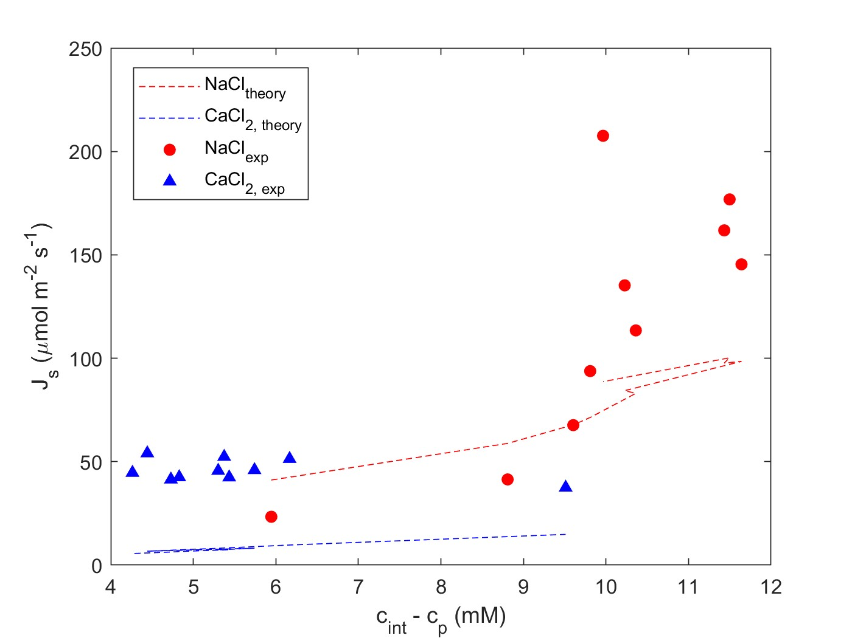
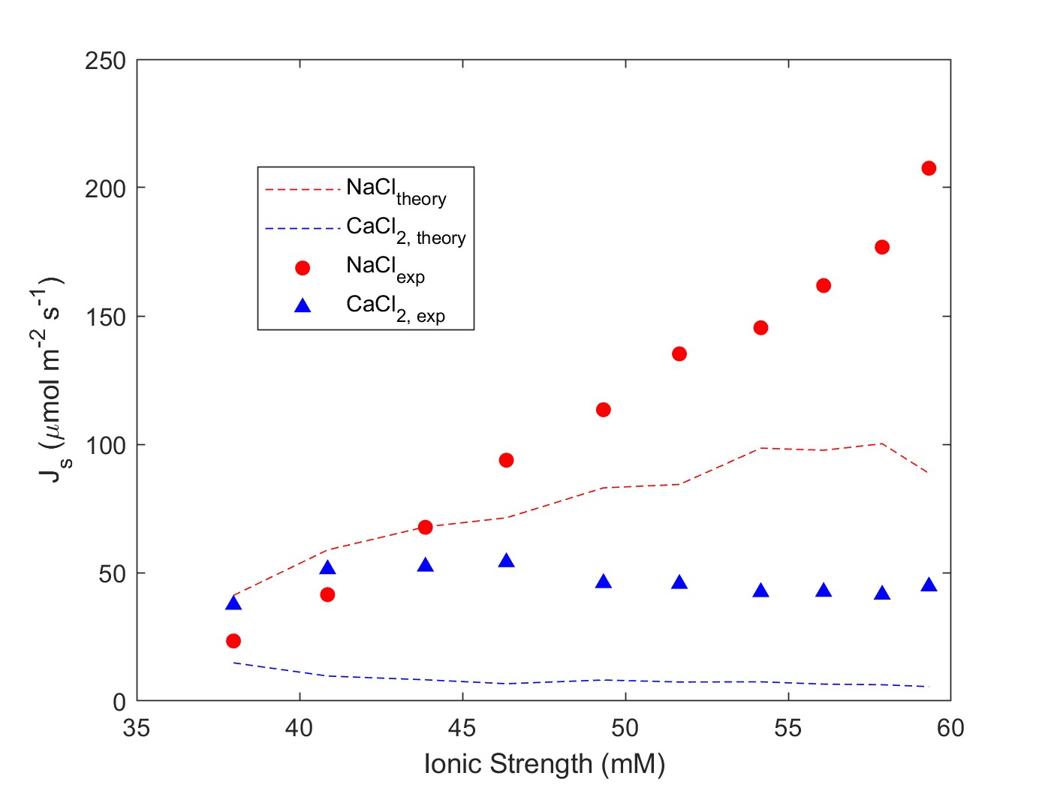
Multicomponent: NaCl, CaCl2
Feed: 10 mM CaCl2
Diafiltrate: 4 mM CaCl2; 50 mM NaCl
NF270_MC2, 05.08.24_E1

Slide 7
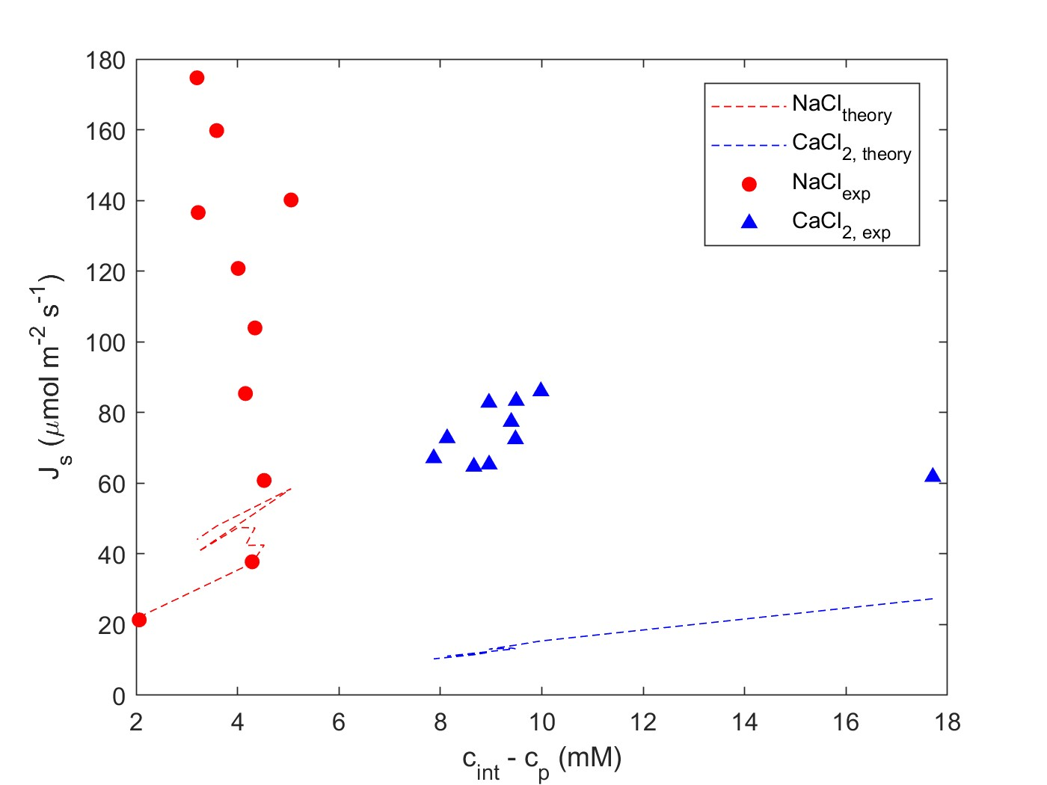
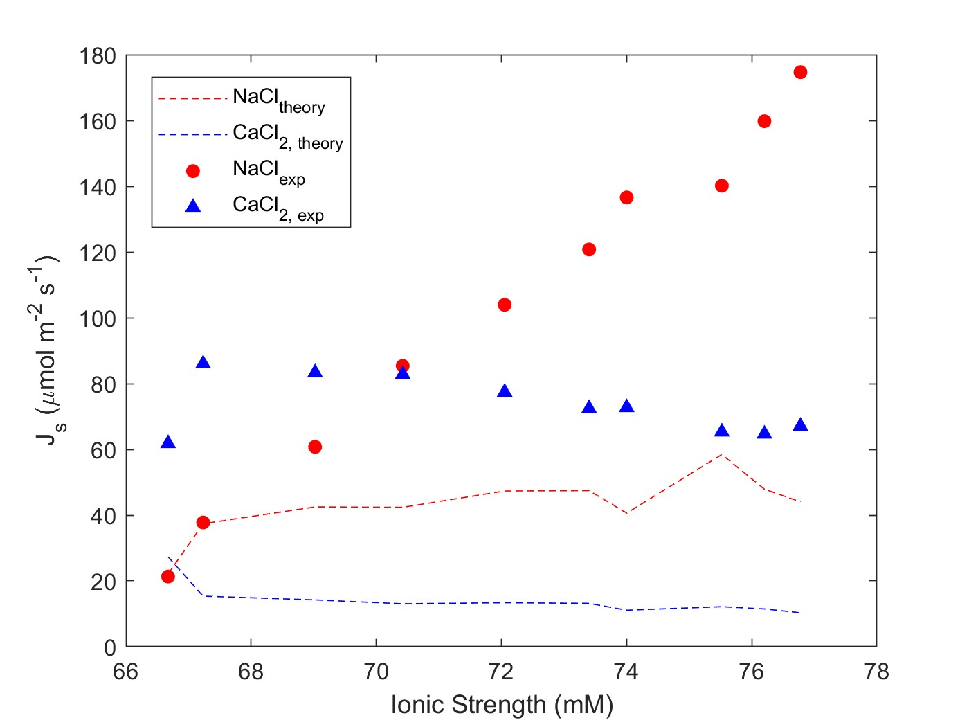
NF270_MC2, 05.08.24_E2
Multicomponent: NaCl, CaCl2
Feed: 20 mM CaCl2
Diafiltrate: 8 mM CaCl2; 50 mM NaCl

Slide 8
Multicomponent: NaCl, CaCl2
Feed: 10 mM NaCl
Diafiltrate: 5 mM NaCl; 50 mM CaCl2
NF270_MC5, 06.05.26_E3

Slide 9
Multicomponent: NaCl, CaCl2
Feed: 20 mM NaCl
Diafiltrate: 10 mM NaCl; 50 mM CaCl2
NF270_MC5, 06.05.26_E4

Slide 10
Multicomponent: NaCl, CaCl2
Feed: 10 mM NaCl; 1 mM CaCl2
Diafiltrate: 50 mM NaCl; 50 mM CaCl2
NF270_MC2, 05.09.24_E5

Slide 11
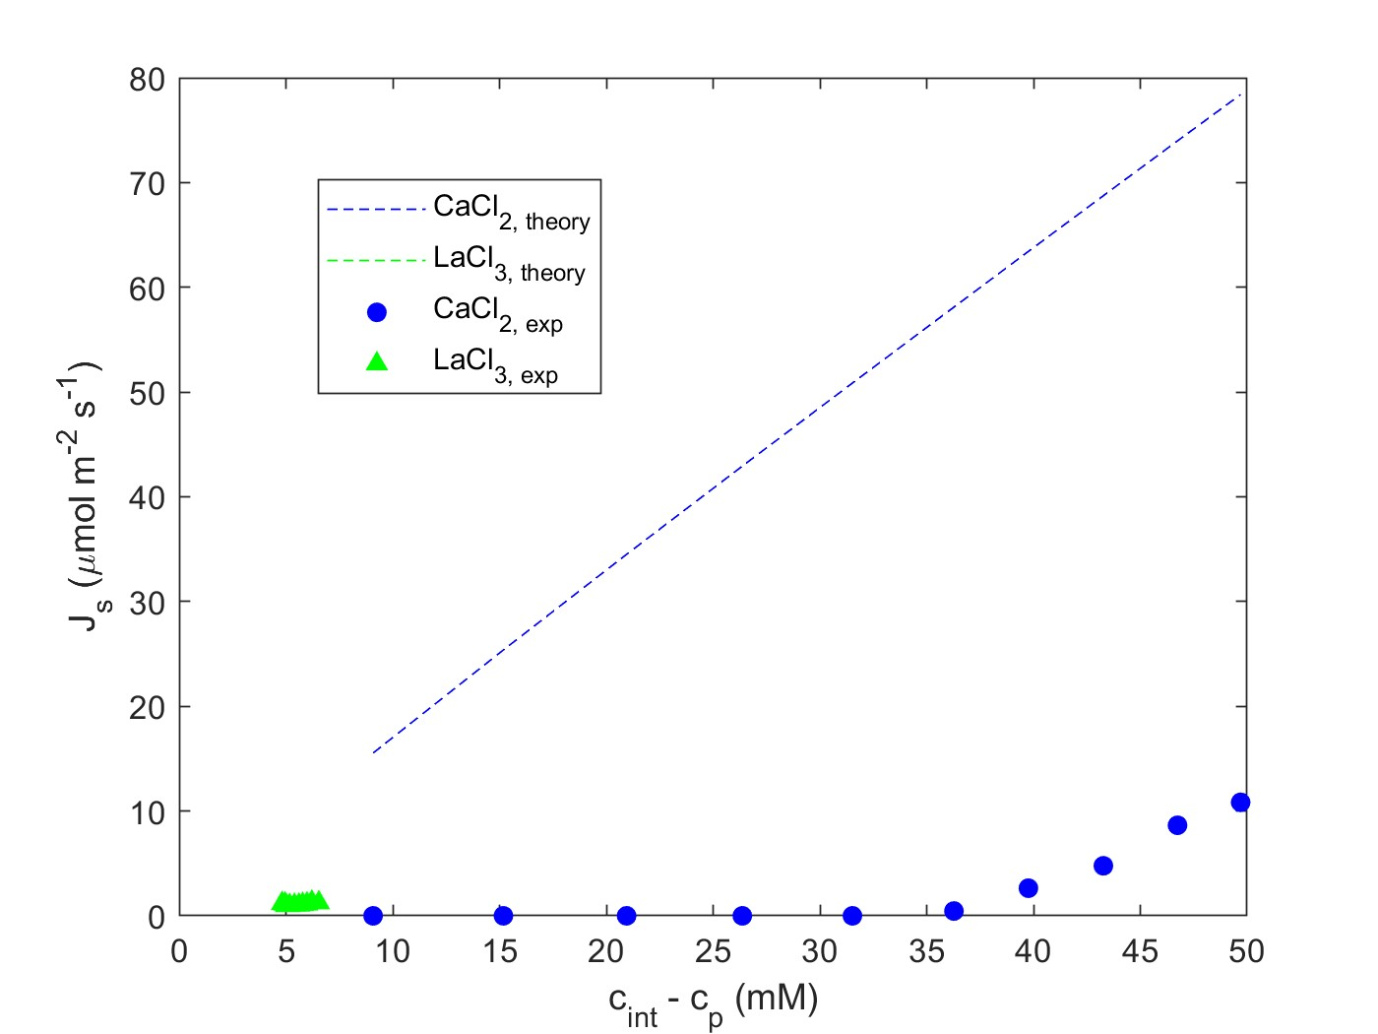
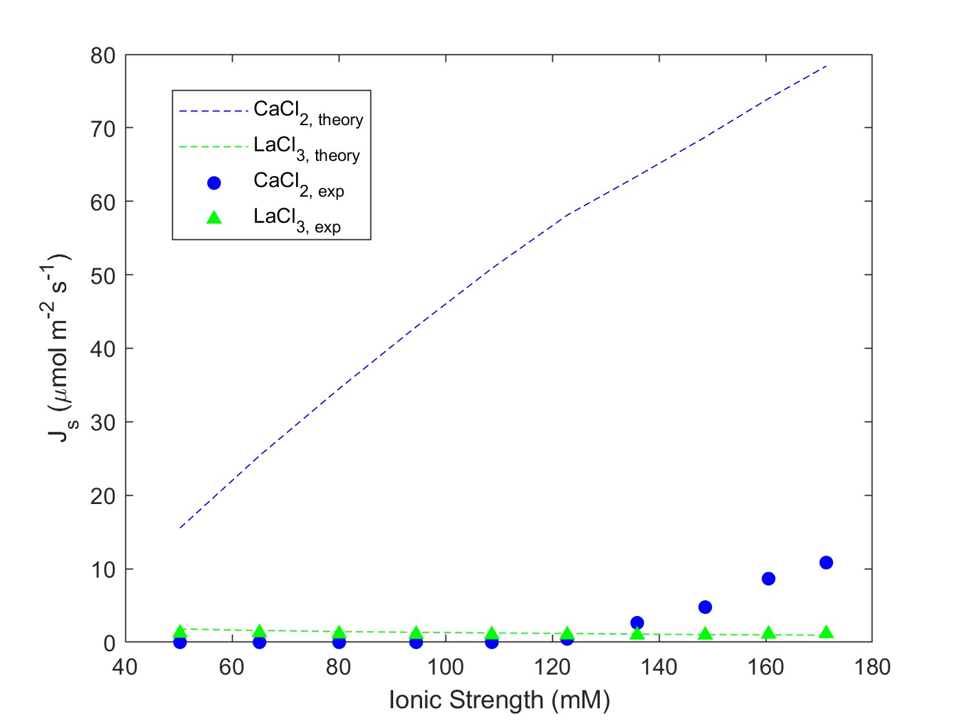
Multicomponent: CaCl2, LaCl3
Feed: 5 mM LaCl3
Diafiltrate: 0.4 mM LaCl3; 50 mM CaCl2
NF270_MC2, 05.21.24_E6

Slide 12
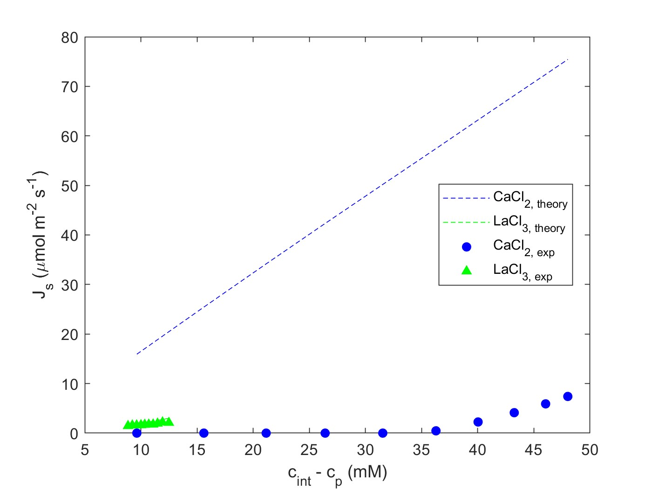
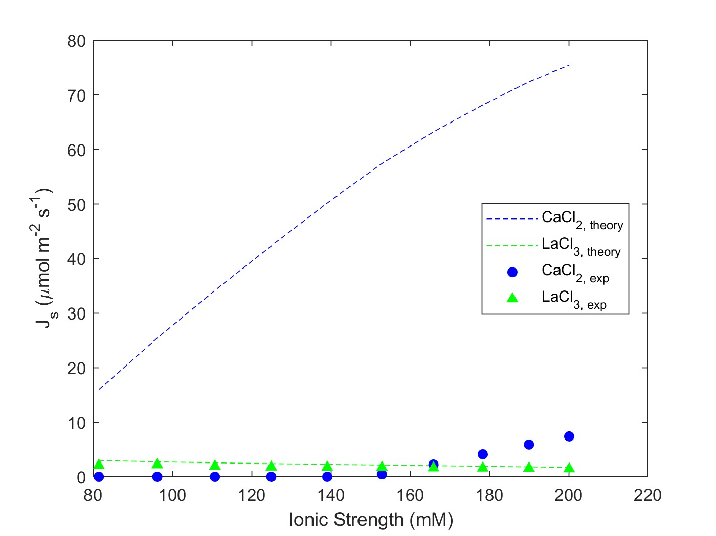
Multicomponent: CaCl2, LaCl3
Feed: 10 mM LaCl3
Diafiltrate: 0.4 mM LaCl3; 50 mM CaCl2
NF270_MC2, 05.21.24_E7

Slide 13
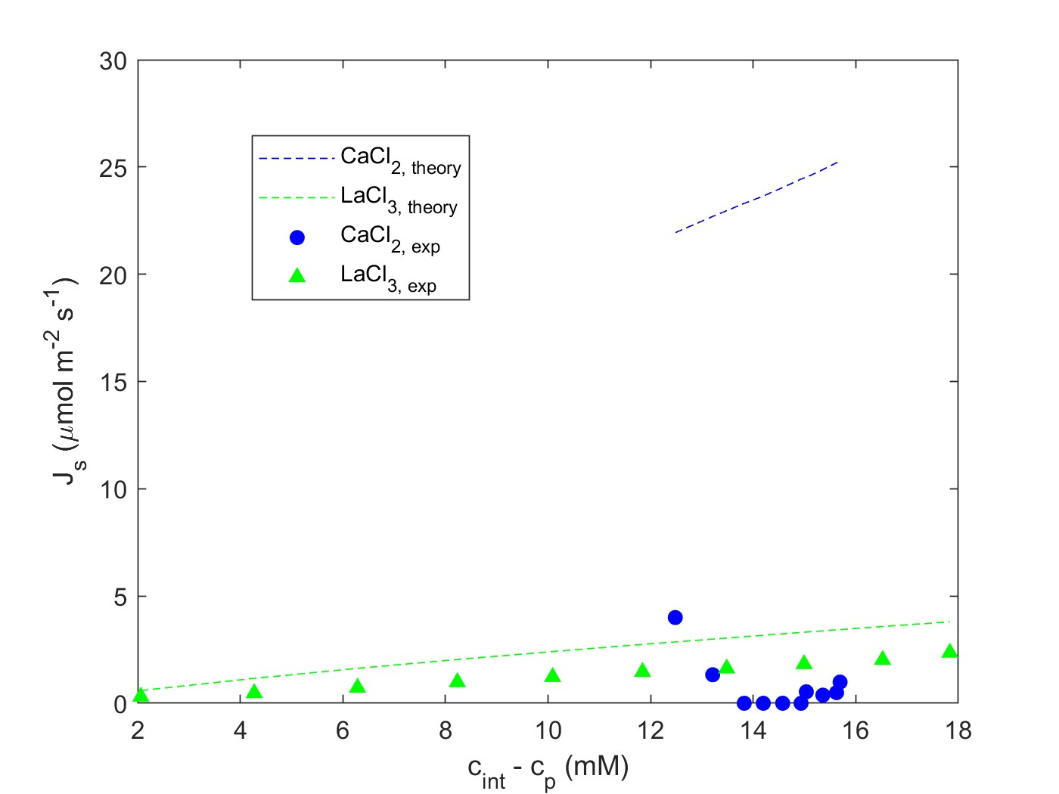
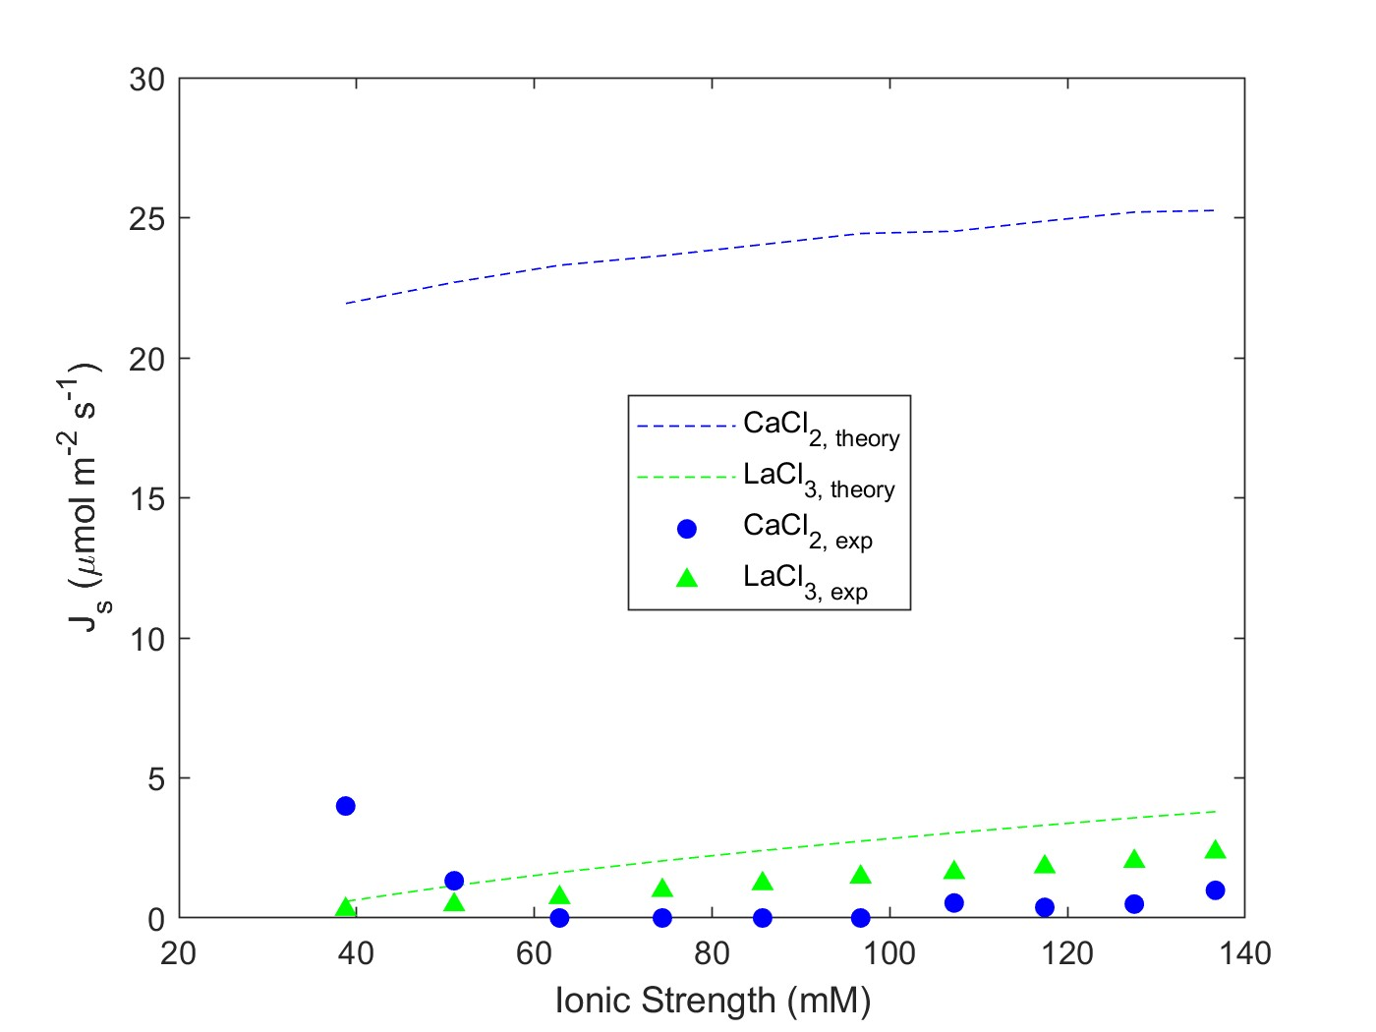
Multicomponent: CaCl2, LaCl3
Feed: 10 mM CaCl2
Diafiltrate: 6 mM CaCl2; 15 mM LaCl3
NF270_MC2, 05.22.24_E8

Slide 14
NF270_MC5, 09.08.25_E9
Multicomponent: CaCl2, LaCl3
Feed: 20 mM CaCl2
Diafiltrate: 12 mM CaCl2; 15 mM LaCl3

Slide 15
NF270_MC2, 05.22.24_E10
Multicomponent: CaCl2, LaCl3
Feed: 1 mM LaCl3; 5 mM CaCl2
Diafiltrate: 10 mM LaCl3; 25 mM CaCl2

Slide 16
Multicomponent: CaCl2, LaCl3
Feed: 50 mM CaCl2; 1 mM LaCl3
Diafiltrate: 20 mM LaCl3
NF270_MC4, 07.16.24_E17

Slide 17
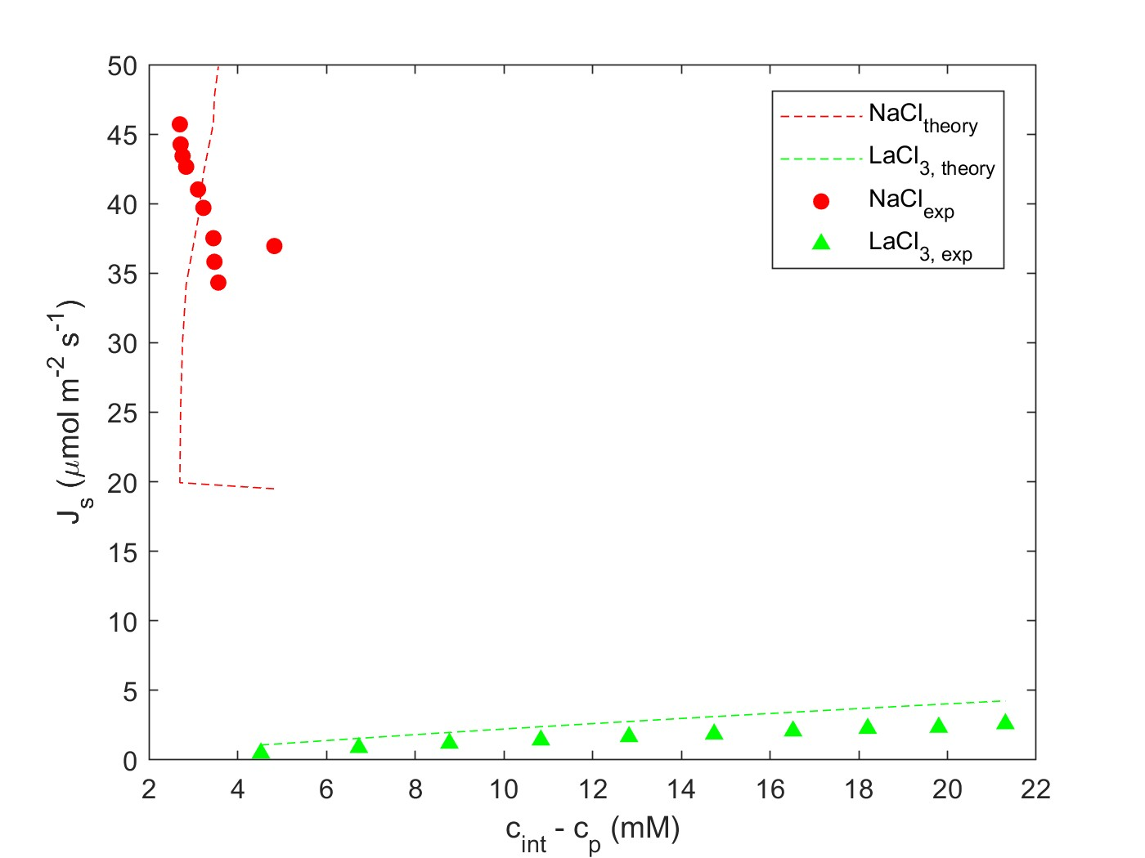
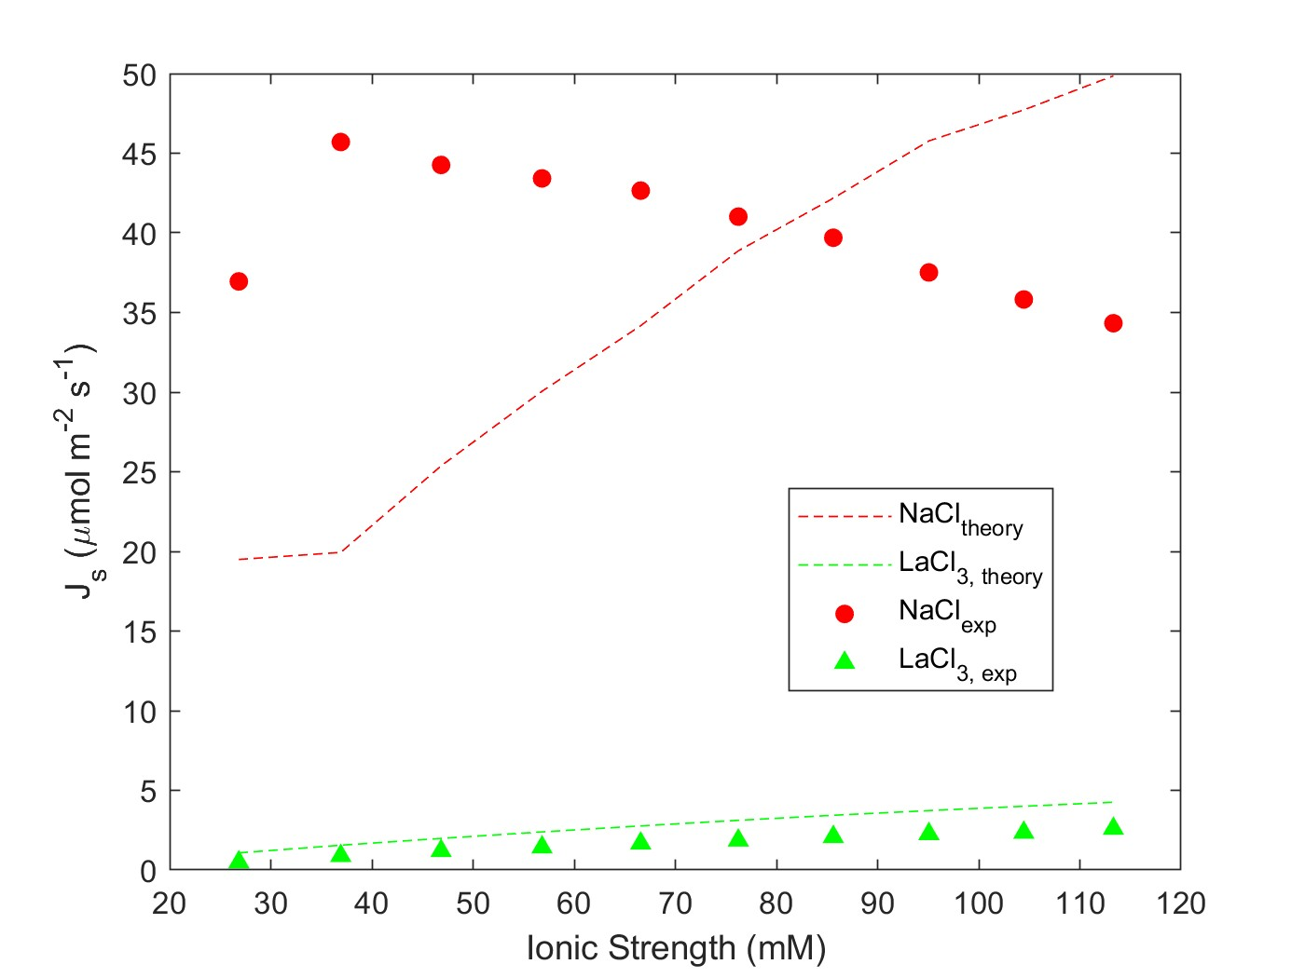
Multicomponent: NaCl, LaCl3
Feed: 10 mM NaCl
Diafiltrate: 5 mM NaCl; 15 mM LaCl3
NF270_MC2, 05.28.24_E11

Slide 18
Multicomponent: NaCl, LaCl3
Feed: 20 mM NaCl
Diafiltrate: 10 mM NaCl; 15 mM LaCl3
NF270_MC2, 05.28.24_E12

Slide 19
NF270_MC4, 07.12.24_E13
Multicomponent: NaCl, LaCl3
Feed: 5 mM LaCl3
Diafiltrate: 0.2 mM LaCl3; 50 mM NaCl

Slide 20
NF270_MC5, 09.09.25_E14
Multicomponent: NaCl, LaCl3
Feed: 10 mM LaCl3
Diafiltrate: 0.4 mM LaCl3; 50 mM NaCl

Slide 21
Multicomponent: NaCl, LaCl3
Feed: 10 mM NaCl; 1 mM LaCl3
Diafiltrate: 50 mM NaCl; 10 mM LaCl3
NF270_MC2, 05.30.24_E15

Slide 22
NF270_MC4, 07.16.24_E16
Multicomponent: NaCl, LaCl3
Feed: 50 mM NaCl; 1 mM LaCl3
Diafiltrate: 10 mM NaCl; 20 mM LaCl3

